Slide 1


Team 505: SAE Hybrid Vehicle Battery Box and Battery Management System
19-Feb-19

Slide 2






Team Introductions
William Pisani
Cooling Specialist
Raymond Klouda
Impact Engineer
Thomas O’Neill
Project Manager
Christopher Fishman
BMS Engineer
Christian Gaya
Battery Engineer

Slide 3



Sponsor and Advisor
Sponsor Liaison
Michael Hays
Technical Specialist at Cummins
Academic Advisor
William Oats, Ph.D.
FAMU-FSU College of Engineering Professor
William Pisani

Slide 4
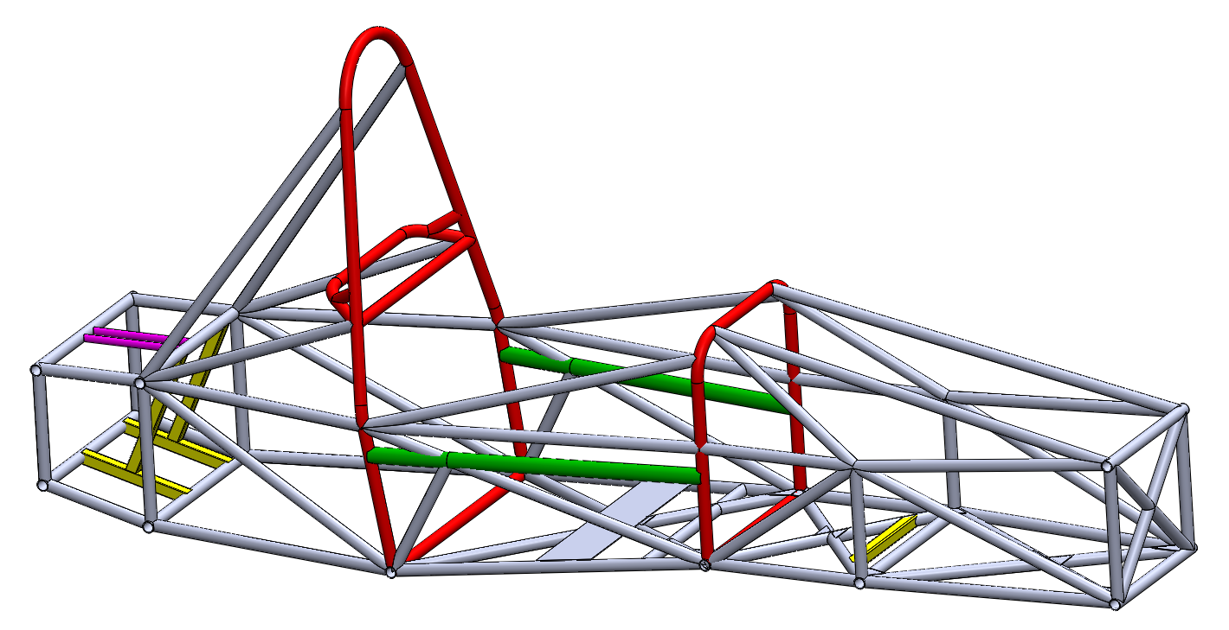

Objective
Build a battery box and battery management system (BMS) for the SAE hybrid vehicle competition team
William Pisani

Slide 5

Customer Needs
Interpreted Needs
  Design a program that takes in parameters about motors and outputs information about the battery system
  The battery box protects the battery, prevents overheating, and avoids environmental impact
  A small-scale prototype should be created with proper specifications
  BMS maintains charge control, cell balancing, and monitors power input and output
  Battery system for a momentary high-torque boost should be a focal point of the BMS system
  The battery box and BMS both adhere to SAE competition guidelines
William Pisani

Slide 6

Functional Decomp
Battery System
Battery Containment
Battery Management System
Support
Monitor
Integrate
Configure
Control
External Forces
Battery Load
Vehicle Chassis
Battery Layout
Temperature
Control
Charge
Current Flow
Voltage Level
Power Output
Batteries
Temperature
William Pisani

Slide 7
Functional Decomp
Battery Containment
Support
Integrate
Configure
Control
External Forces
Battery Load
Vehicle Chassis
Battery Layout
Temperature
William Pisani

Slide 8
Functional Decomp
Battery System
Battery Containment
Battery Management System
Support
Monitor
Integrate
Configure
Control
External Forces
Battery Load
Vehicle Chassis
Battery Layout
Temperature
Control
Charge
Current Flow
Voltage Level
Power Output
Batteries
Temperature
William Pisani

Slide 9
Functional Decomp
Battery Management System
Monitor
Control
Charge
Current Flow
Voltage Level
Power Output
Batteries
Temperature
William Pisani

Slide 10

Concept Generation
Biomimicry
    Analytically apply our problem to nature and brainstorm nature's own solutions
Anti-Problem
    Project problems were reversed, and possible solutions to these anti-problems were found
Morphological Chart
    Lists functions and various mechanisms that can be used to perform the functions listed
    Includes the ideas we found from biomimicry, anti-problems, and the customer needs
    Lines can be used to connect the rows and columns of the chart. Each line represents a different possible concept
William Pisani
10

Slide 11

Concept Selection
House of Quality
  Compared customer requirements to engineering characteristics (evaluation criteria)
  Generated the proper evaluation criteria for the Pugh charts
Pugh Charts
  Determined most important design concepts based on the evaluation criteria through comparing each concept to a datum
Analytical Hierarchy Process
  “Mathy” way to make a decision
  Equations were used for each evaluation criteria and design concept
William Pisani

Slide 12

Embodiment
Thomas O’Neill

Slide 13
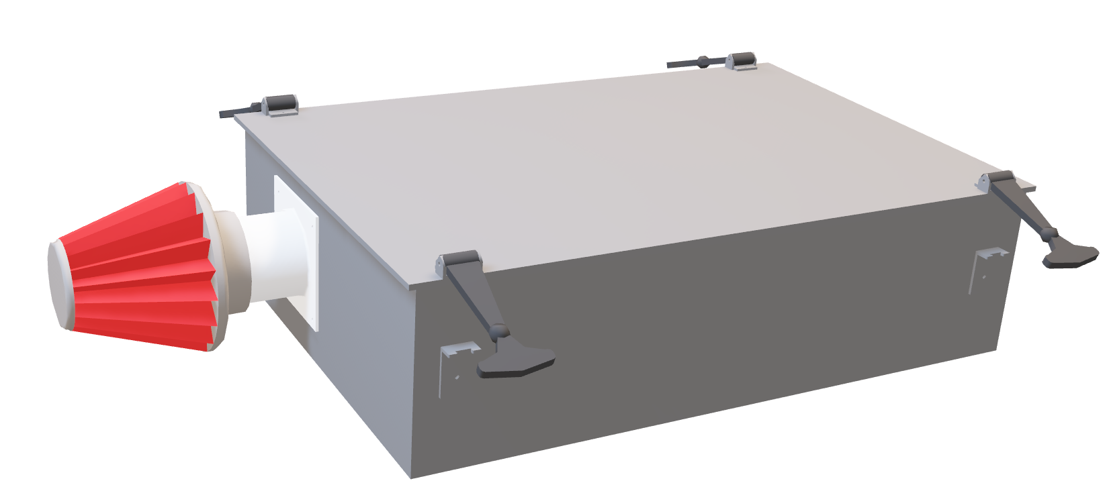
Thomas O’Neill

Slide 14
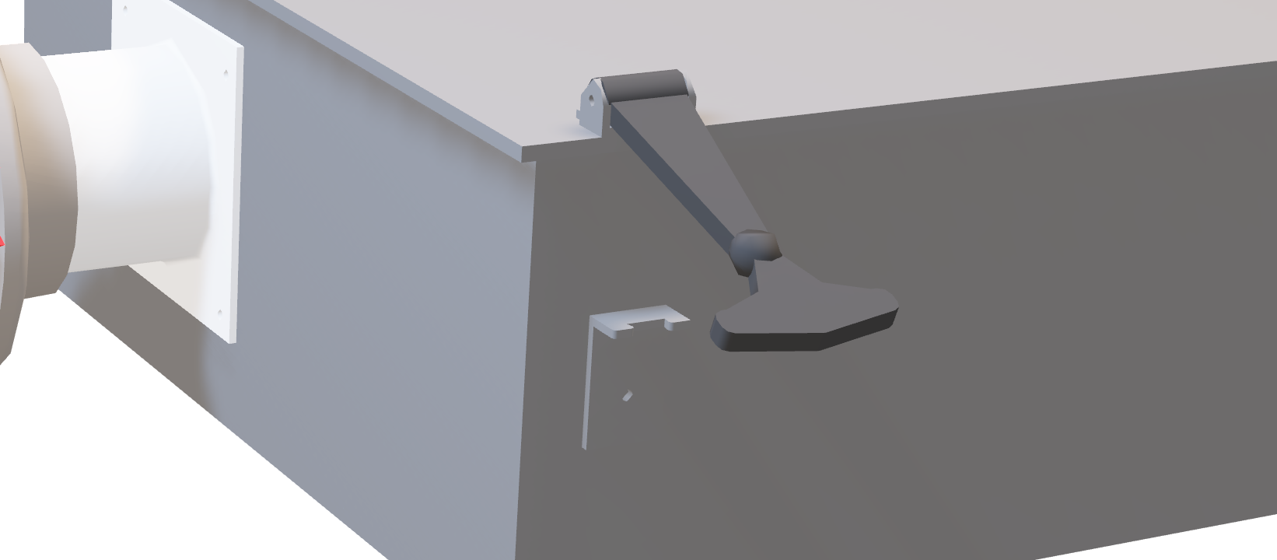
Thomas O’Neill

Slide 15

Thomas O’Neill

Slide 16
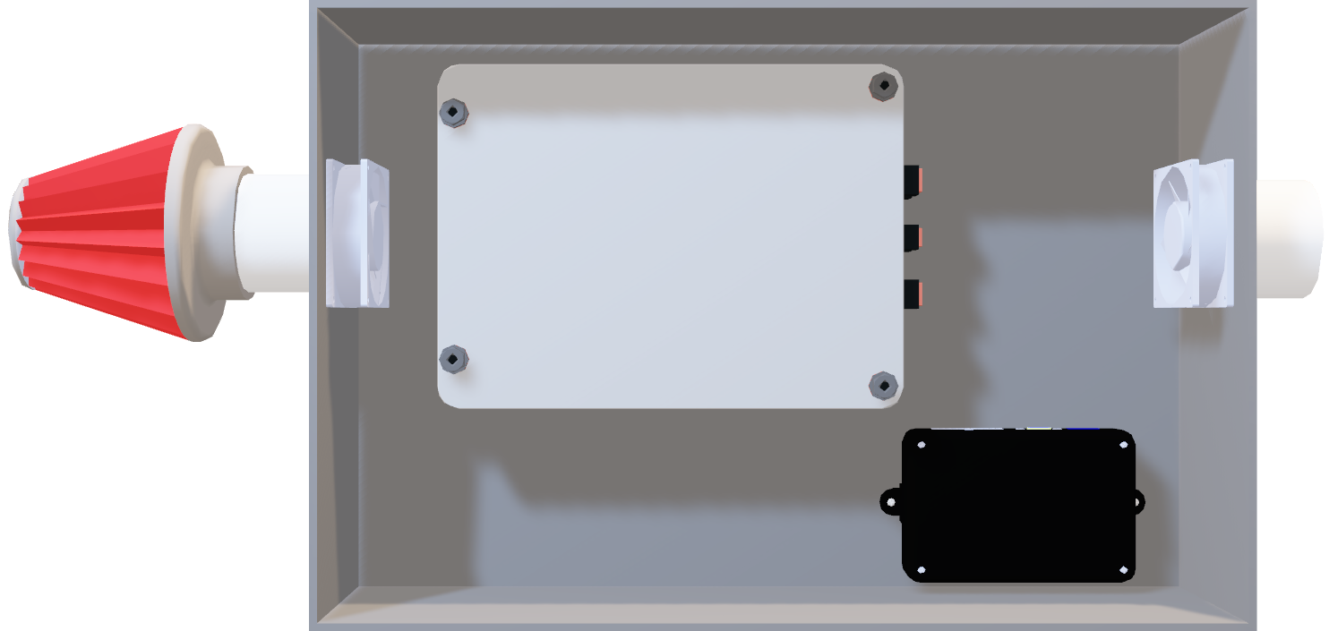
Thomas O’Neill

Slide 17

Thomas O’Neill

Slide 18

Manufacturing
Christopher Fishman

Slide 19

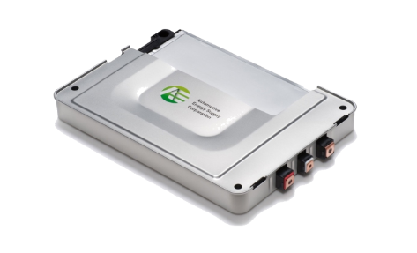
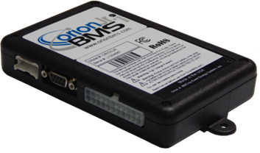
Electrical Components Assembly
Nissan Leaf Modules and Orion Jr. BMS
  Integrate components together by following manufacturers specifications for series battery configuration.
BMS requires 9-60V for operating power
  2 supplies: battery pack, and 120:12 V adapter
  Converter emulates car alternator
Christopher Fishman

Slide 20

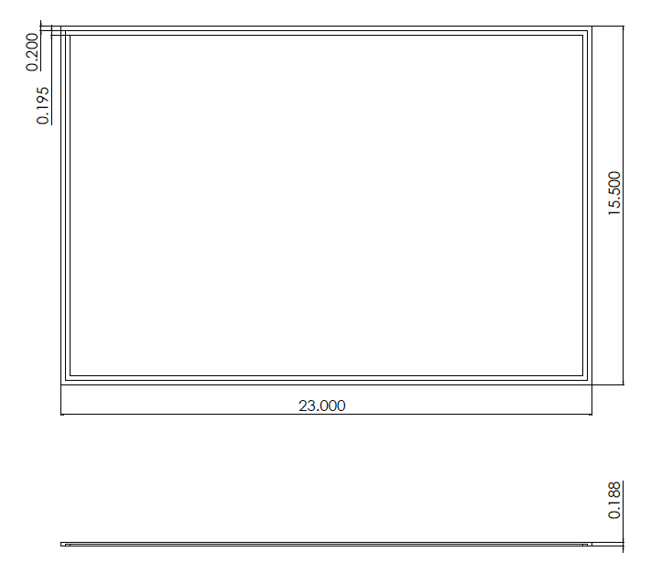
Manufacturing Drawings
Thomas O’Neill

Slide 21
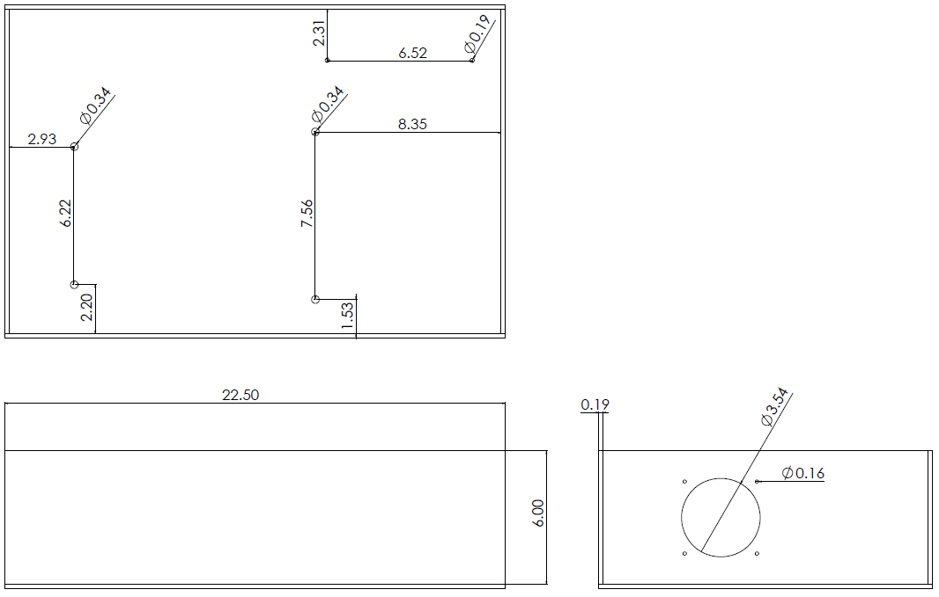
Manufacturing Drawings
Thomas O’Neill

Slide 22

Testing
Christopher Fishman

Slide 23

Testing Electrical Systems
Discharge characteristics of Nissan Leaf Modules
  Voltage change over time during constant-current discharge
  Estimated charge life for an individual module
  Charge life data can be extrapolated for full-scale battery pack
Time required to bring modules to full-charge from different voltage levels of the modules
  Post-discharge, activate charging circuit and document results
Temperature monitors
  Controlled-climate testing of thermistors to ensure proper calibration
Water test the charge/discharge circuit pass-through connectors
Christopher Fishman

Slide 24

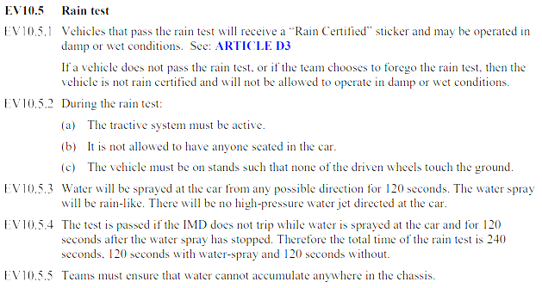
Testing the Battery Box
Thomas O’Neill

Slide 25
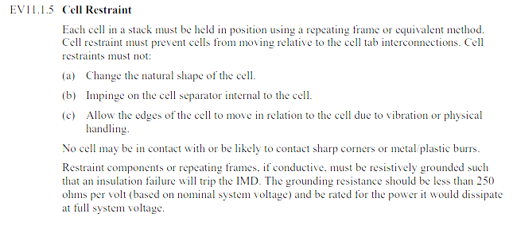
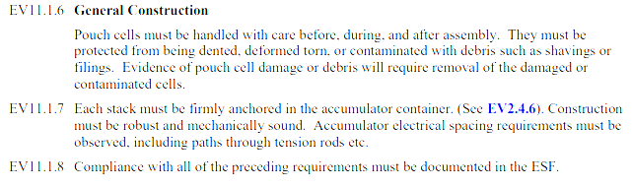
Testing the Battery Box
Thomas O’Neill

Slide 26

Project Management
Christopher Fishman

Slide 27
Project Timeline
Item No. | Date Entered | Information | Decision | Action | Progress | Status | Date Complete
1 | 1/31/2019 | BMS Shipment | Y | Order BMS from aproved vendor and bring purchsing form to purchasing department | 100% | Delivered | 2/4/2019
2 | 1/31/2019 | Battery Shipment | Y | Order battery from aproved vendor and bring purchsing form to purchasing department | 100% | Delivered | 2/12/2019
3 | 1/31/2019 | Material Shipment | N | Source aluminum from aproved vendor with reasosable shipping time | 10% | Sourced
4 | 1/31/2019 | Tools | Y | Purchase high voltage tool set | 10% | Sourced
5 | 1/31/2019 | CAD | Y | Develop CAD drawing for full scale and small scale models | 75% | Started
6 | 1/31/2019 | FEA | Y | Test full scale model to ensure it can withstand expected external forces | 50% | In progress
7 | 1/31/2019 | Thermal Analysis | Y | Ensure cooling system can keep batteries within operating temperatures | 25% | Research
8 | 1/31/2019 | Machine Shop | N | Bring materials and approved drawings to machine shop | 25% | Meeting
9 | 1/31/2019 | BMS Programming | Y | Identify battery module parameters. Use these parameters to program the bms to ensure proper functionality. | 10% | In progress
10 | 1/31/2019 | Wiring | Y | Follow proper wiring connections as specified by schematics provided by Orion | 0% | Not started
11 | 1/31/2019 | BMS Testing | Y | Discharge battery modules using constant-current discharge circuit and monitor the change in voltage. After discharge, activate charging circuit and document the current input. Document the time required to reach different states of charge. | 0% | Not Started
12 | 1/31/2019 | Box Testing | Y | Box will be subdued to a destructive test | 10% | Research
13 | 1/31/2019 | Misc. Materials Shipment | Y | Bolts, Fasseners, and various other other materials will be sourced and shipped from approved vendors | 10% | Sourced
Christopher Fishman

Slide 28

Most Important Points
Arrival of crucial components of the project
CAD prototype completed
FEA to proceed for full scale model
Specifications complete to begin construction of physical model after FEA
Test proposal for determination of functionality, performance, and health of the battery modules
Christopher Fishman

Slide 29

Lessons Learned
Everything takes longer than expected
Christopher Fishman

Slide 30
Reference
Motors. (n.d.). Retrieved February, 2019, from http://www.evwest.com/catalog/index.php?cPath=8
Fuel Economy Retrieved February, 2019, from https://www.fueleconomy.gov/feg/hybridtech.shtml.
800hp Electric Pickup Retrieved February, 2018, from https://www.hardworkingtrucks.com/rivian-reveals-chassis-of-800-hp-electric-pickup/
2019 Formula SAE Rules. Retrieved February, 2019, from https://formula-hybrid.org/wp-content/uploads/2019-Formula-Hybrid-Rules-Rev-0.pdf

Slide 31

Questions

Slide 32
Backup Slides

Slide 33
Functional Decomp Backup

Slide 34
Customer Needs Chart
Question/Prompt ​ | Customer Statement ​ | Interpreted Need ​
Should we build a battery box specific to the current SAE hybrid vehicle? ​ | I want to be able to provide parameters about the battery that the box is holding and get values returned about the size of the box. ​ | A program should take parameters about a battery and output parameters about a battery box. ​
Should a physical model of the battery box be built? ​ | The main item I'm looking for is the program that will give me values based on the battery. ​ | The main item I'm looking for is the program that will give me values based on the battery. ​
What should the battery box protect from? ​ | The container should be waterproof, thermally insulated,and environmentally sustainable. ​ | The battery box protects the battery. Thebattery box prevents overheating of the battery. The battery box does notnegatively impact the environment. ​
What should the BMS do? ​ | The BMS will maintain charge control and cell balancing of thebattery in a safe and efficient manner while also monitoring power input and output. ​ | BMS maintains charge control, cell balancing, and monitors power input and output. ​
What battery are we using to create a BMS for? ​ | Decide on a series of parallel battery. Whichever work best for the motor that is being used in the vehicle. ​ | Battery system for a momentary high-torque boost should be focal point of the BMS system ​
Should we investigate building our own battery orbuying one off the shelf? ​ | Creating your own battery would be very difficult. I recommendbuying one off the shelf and using that to create a BMS. ​ | Battery will be purchased. ​
Do you think there are any restrictions to the battery box and BMS? ​ | The SAE rulebook for the competition should contain all details about how the vehicles must be built. ​ | The battery box and BMS both must adhere to SAE competition guidelines. ​

Slide 36
Concept Selection Backup

Slide 37
Morphological Chart
Function​ | Option 1​ | Option 2​ | Option 3​ | Option 4​
Box Shape​ | Cube​ | Rectangle​ | Cross​ | T-Shape​
Box Cooling​ | Liquid cooling​ | Aircooling (ventilation)​ | Fans​ | ​
Box Waterproofing​ | Rubber seals​ | Water diversion​ | Silicon Sealant​ | Vacuum Sealed​
Box Mounting​ | Integrated into chassis​ | Bolted into chassis​ | ​ | ​
Energy Storage Device​ | Individual ion-cells​ | Purchase off shelf​ | Capacitor​ | ​
Energy Storage Device Wiring​ | Series​ | Parallel​ | Both series and parallel​ | ​
BMS Measurements​ | Current​ | Voltage​ | Temperature​ | All measurements​
Current Type​ | AC​ | DC​ | ​ | ​
Charging Device​ | Wall power​ | Solar​ | Regeneration​ | ​

Slide 38
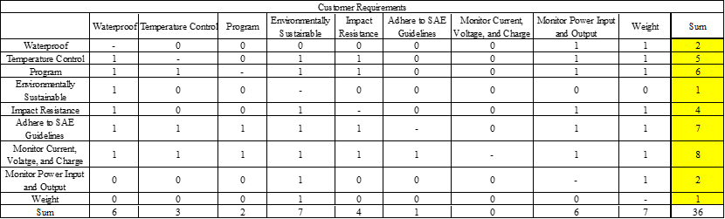
Comparison Matrix

Slide 39
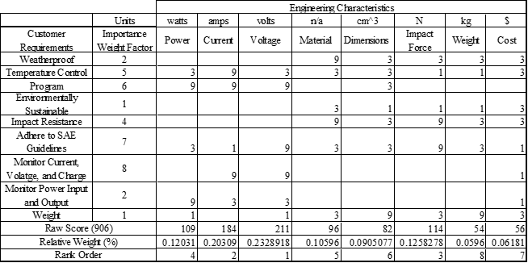
House of Quality

Slide 40
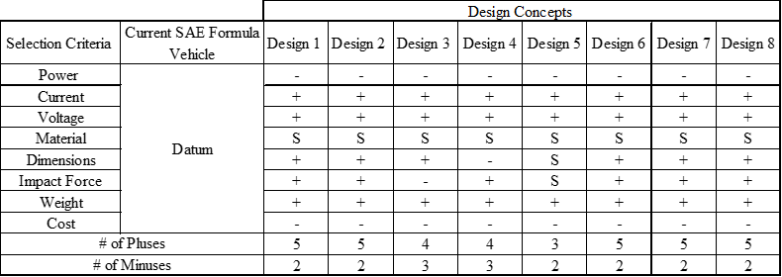
Nine-Design Pugh Chart

Slide 41
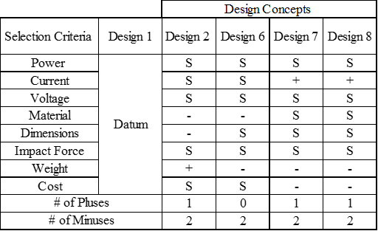
Five-Design Pugh Chart

Slide 42
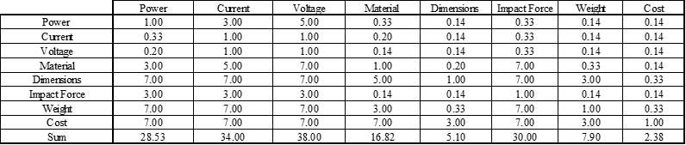
Analytical Hierarchy Process

Slide 43
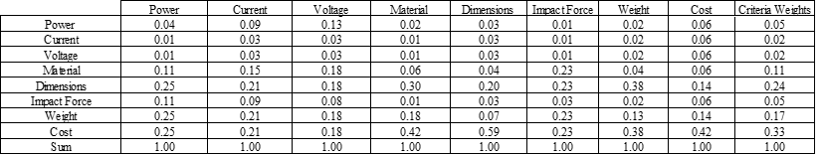
Analytical Hierarchy Process Normalized

Slide 44
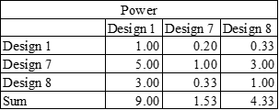
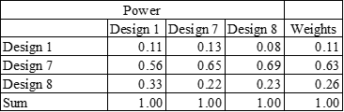
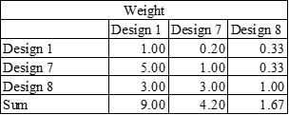
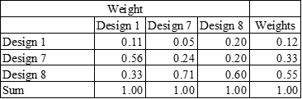
Analytical Hierarchy Process (cont.)

Slide 45
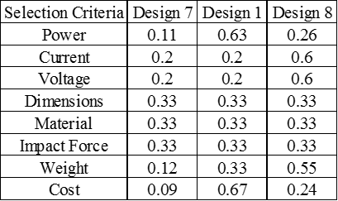
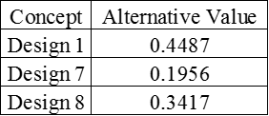
Analytical Hierarchy Process (cont.)

Slide 46
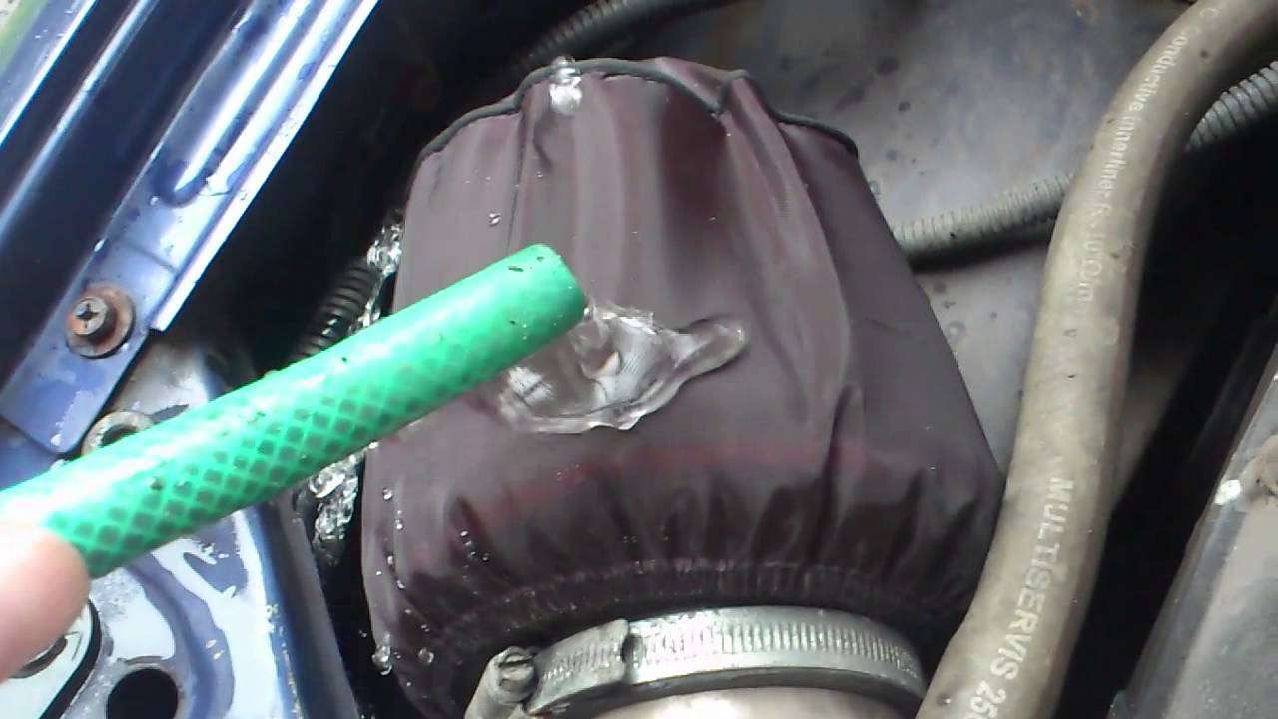
Air intake Hydro shield
Acts as a prefilter
Rejects any particle ~0.005”
Inexpensive
Easy to install

Slide 47
Detailed Math Backup

Slide 50
Standard Shapes
Summary Box
Text box 1
Outlined Text Box

Slide 51




Approved Logos

Slide 52
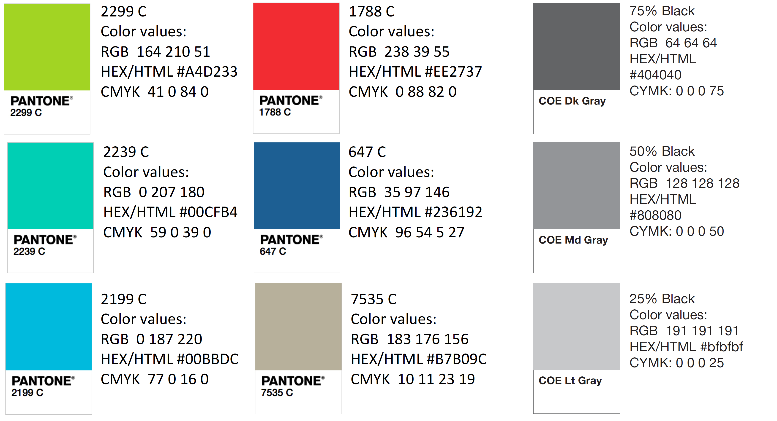
Color Palette

Slide 53
APA Tables
Category 1 | Category 2 | Category 3 | Category 4 | Category 5
Item 1
Item 2
Item 3
Item 4
 | Category 2 |  |  | Category 3
Category 1 | subcategory 1 | subcategory 2 |  | subcategory 1 | subcategory 2
Item 1
Item 2
Item 3
Item 4

